Slide 1
Currently.
Liam Connell
X22511759
Household Appliance Energy Monitoring System

Slide 2
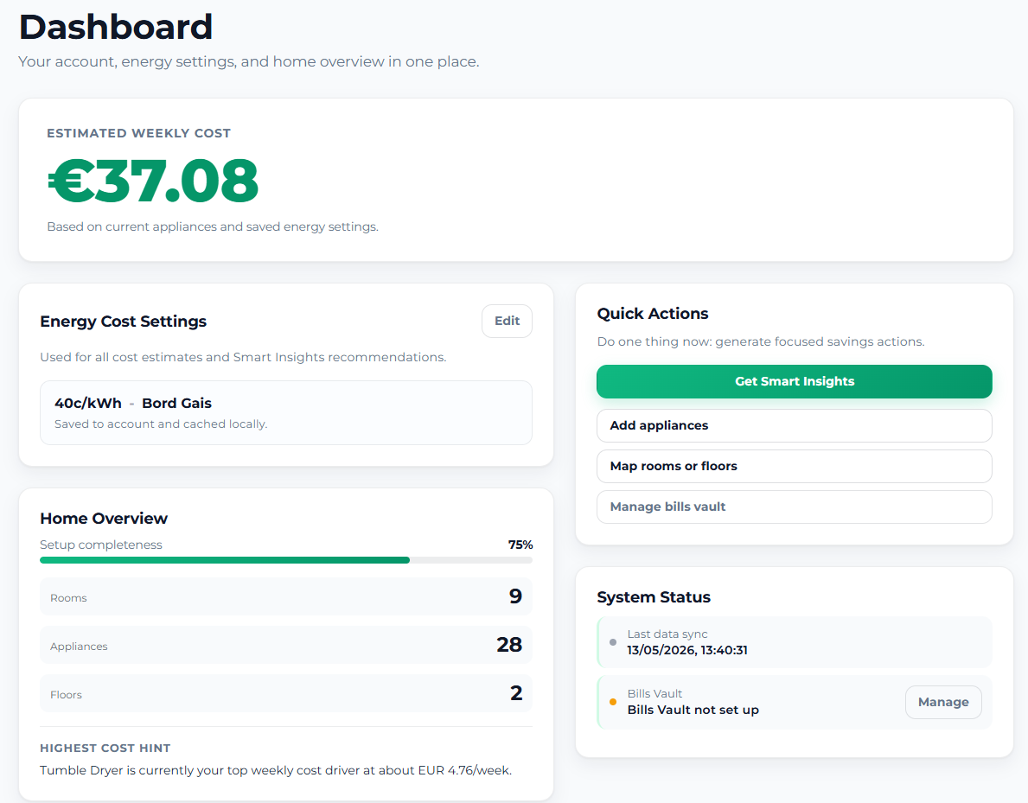

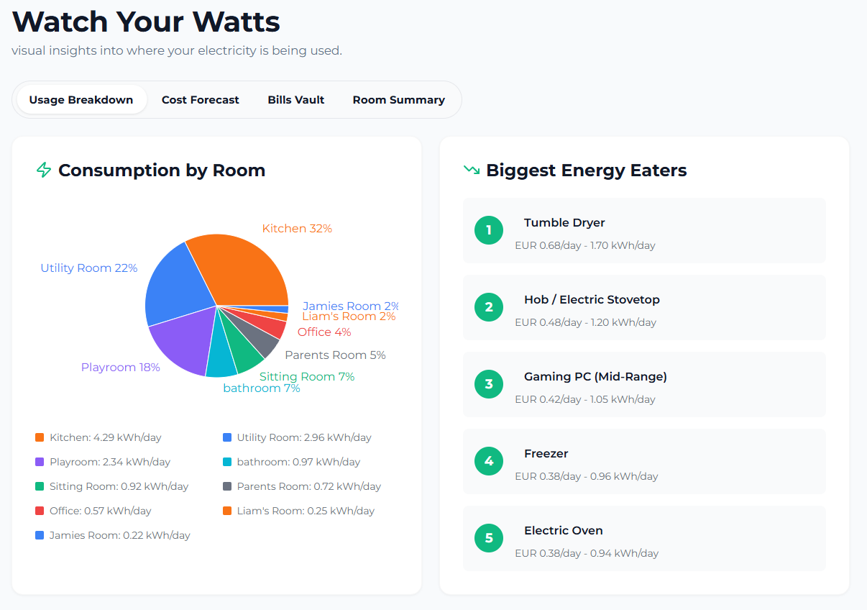
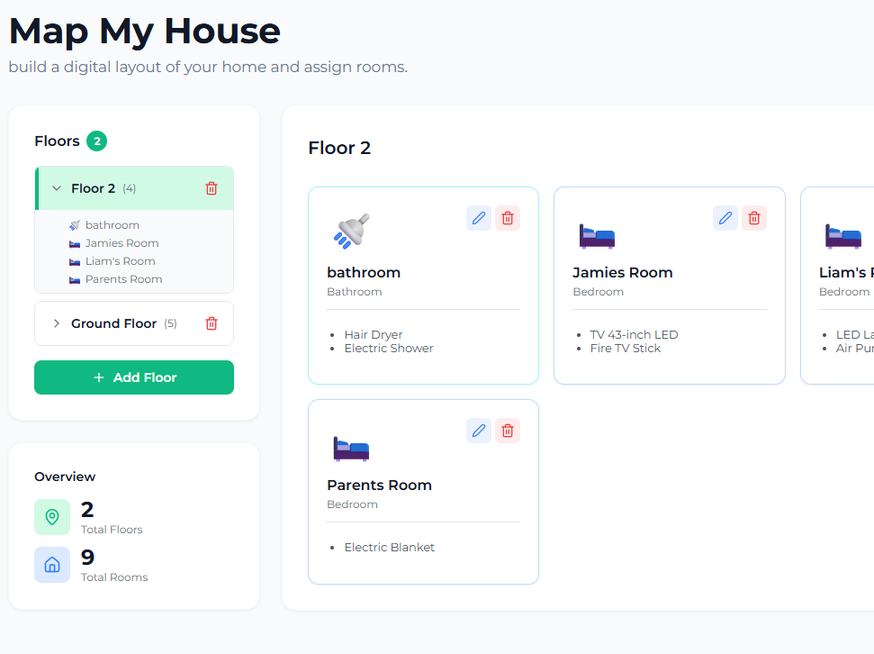
What is Currently? An Overview.
Problem
Rising electricity costs
Electricity bills lack appliance-level visibility
Users lack appliance level understanding
Solution
Currently is a full stack web app that:
Models user household digitally
Tracks appliances usage
Estimates costs based usage
Generates smart insights
Key Differentiator
No hardware needed
Appliance and room level analytics
All user data is handled with secure focused architecture in mind

Slide 3
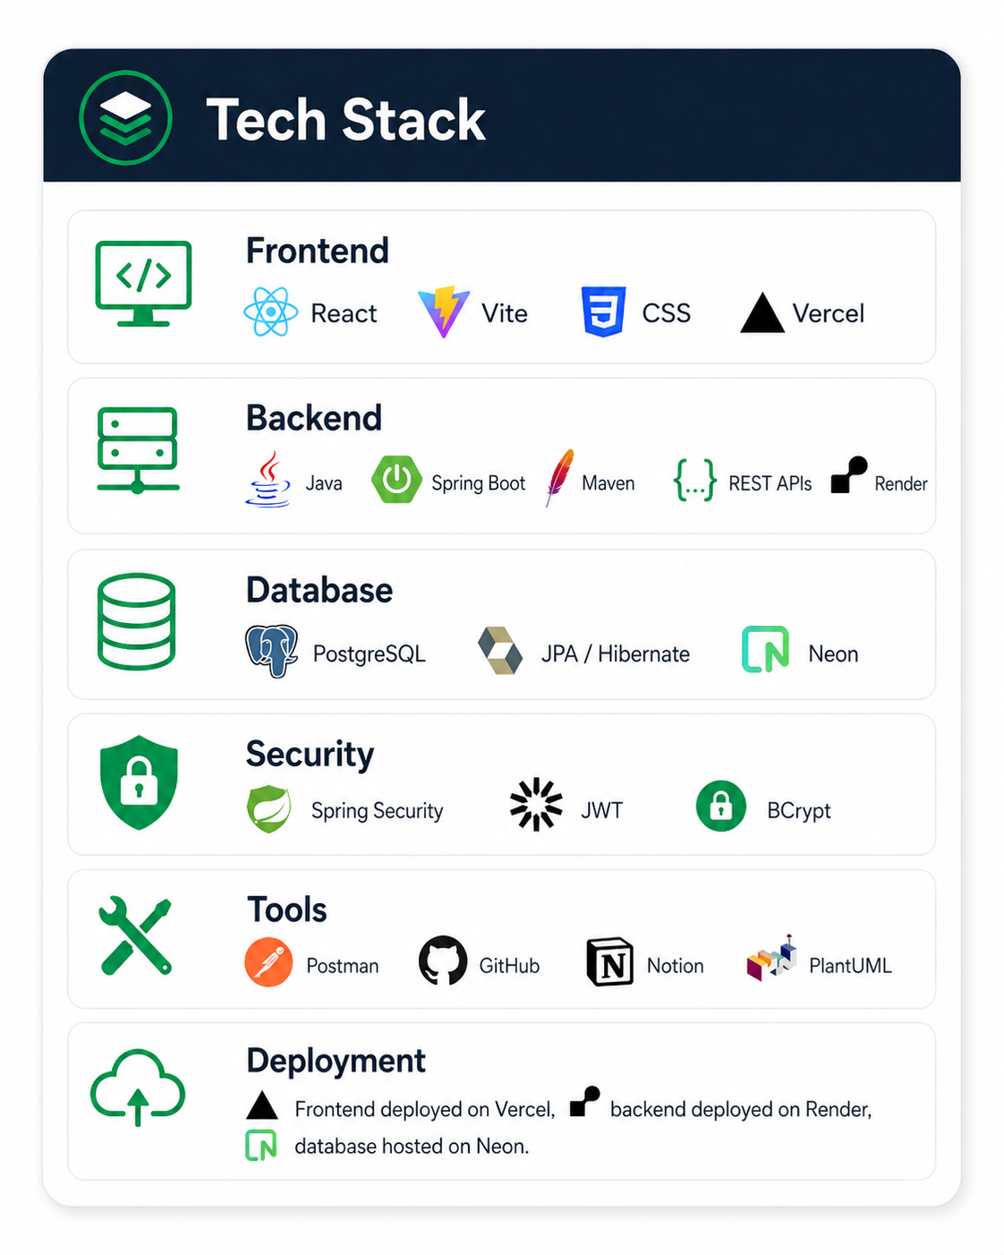
Tech Stack
Frontend: React single-page application built with Vite and CSS
Backend: Java Spring Boot REST API built with Maven
Database: PostgreSQL database accessed through JPA / Hibernate
Security: Spring Security, JWT authentication and BCrypt password hashing
Tools: Postman for API testing, GitHub for version control, PlantUML for diagrams
Deployment: Frontend on Vercel, backend on Render, database on Neon

Slide 4
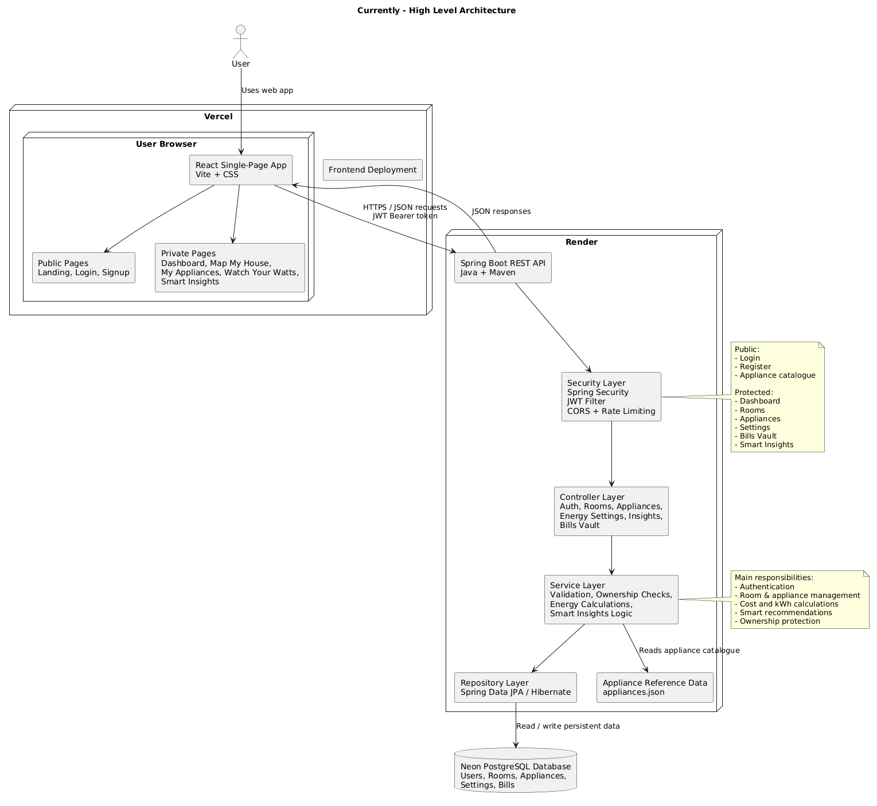
Currently Architecture
User accesses the React app through the browser
React frontend sends HTTPS / JSON requests to the Spring Boot backend
JWT bearer tokens protect private routes and user-specific API requests
Spring Security checks requests before they reach backend controllers
Service layer handles validation, ownership checks, energy calculations and Smart Insights
JPA / Hibernate connects the backend to the Neon PostgreSQL database
Static appliance reference data is loaded from appliances.json

Slide 5
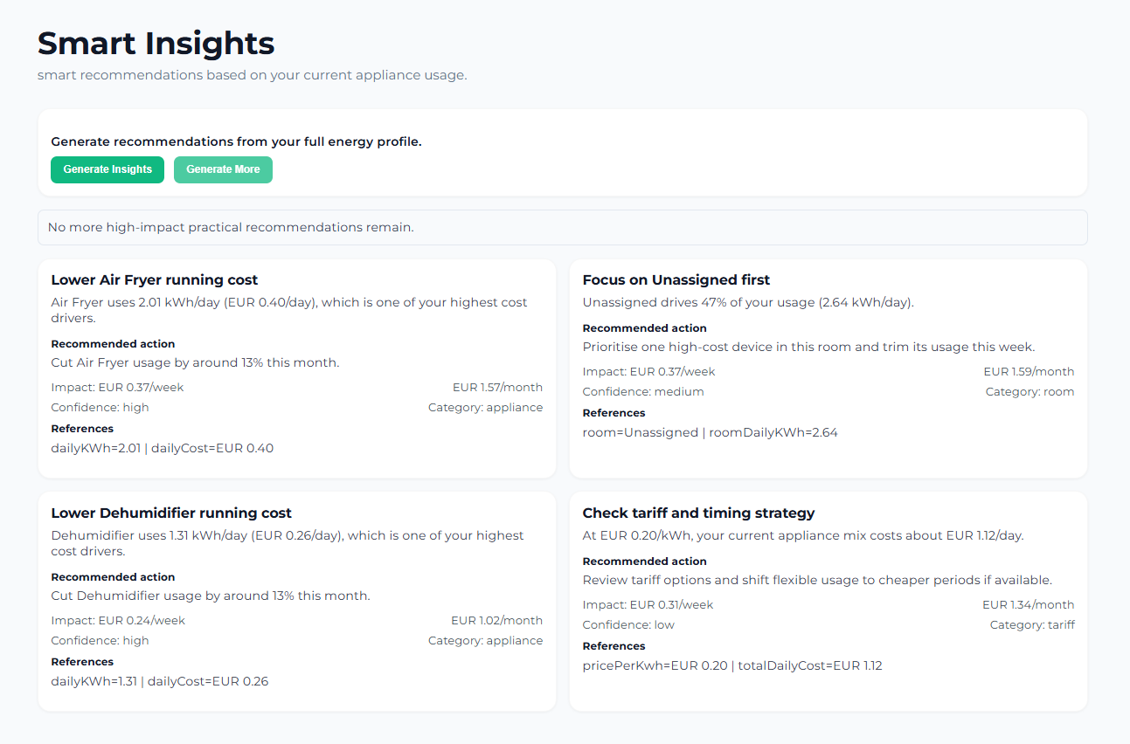
What Makes Currently “Smart”
Created as the app’s key differentiating feature after supervisor feedback
Originally considered AI, but implemented using explainable heuristic maths
Analyses the user’s current appliances, rooms, usage and tariff
Identifies high-cost appliances and high-usage rooms
Generates practical recommendations, not just raw energy data
Shows estimated weekly and monthly savings impact
Labels each insight by category, confidence and reference data
“Generate More” returns extra recommendations in batches
How It Works
Generates recommendation candidates from appliances, rooms, usage and tariff data
Uses heuristic maths instead of AI so results are explainable and testable
Scores each insight by monthly impact, feasibility and confidence
Filters weaker recommendations and limits repeated categories
Returns recommendations in batches through the “Generate More” feature if there is any more to suggest

Slide 6
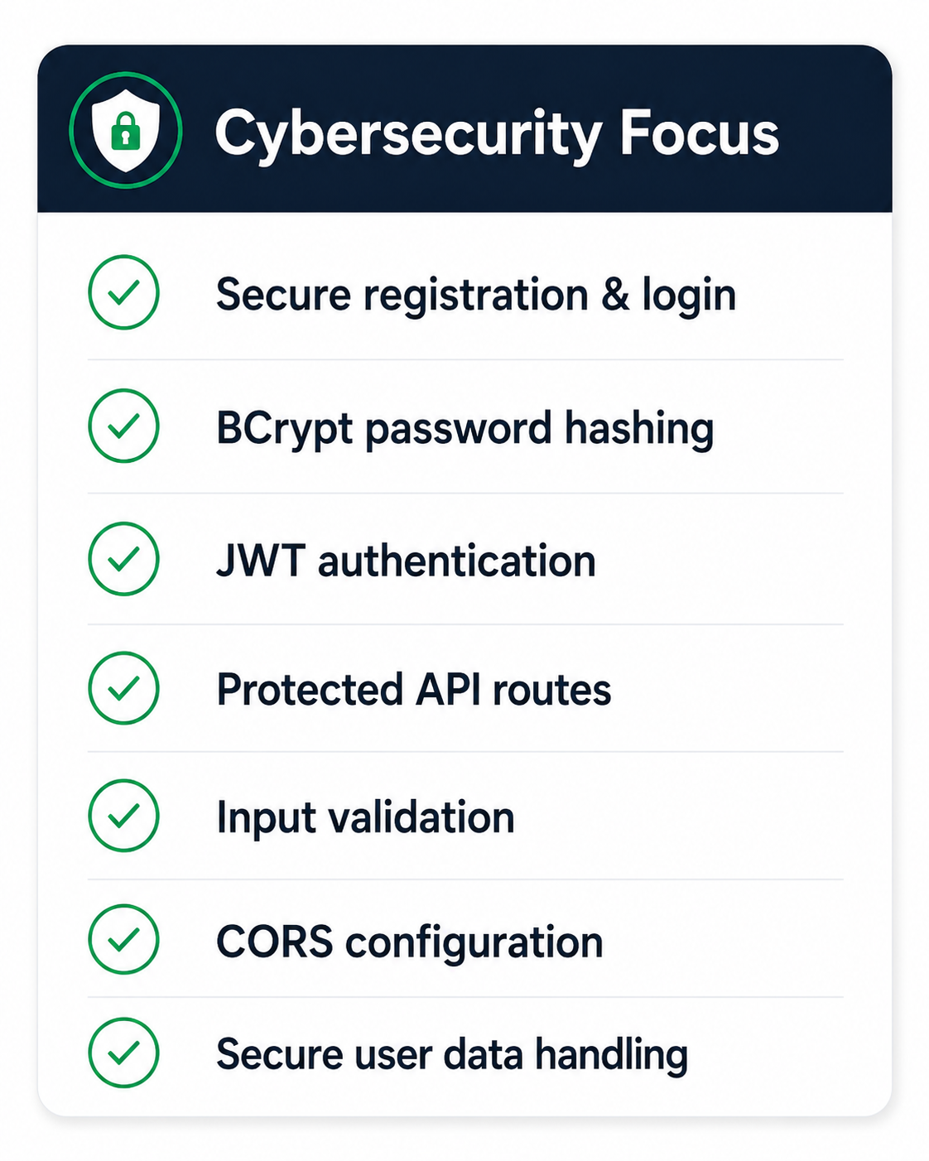
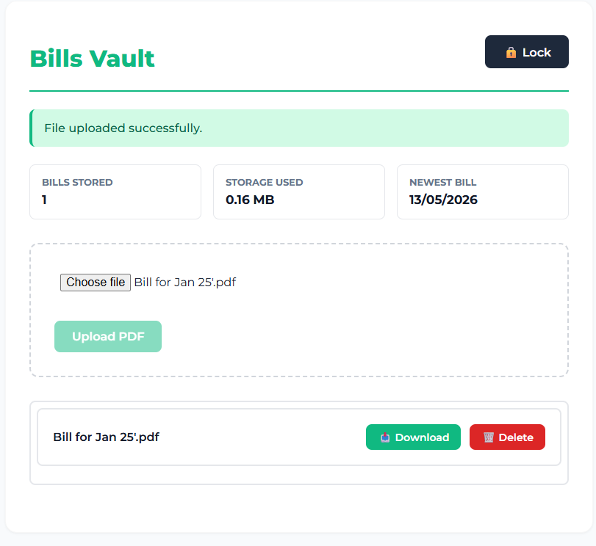
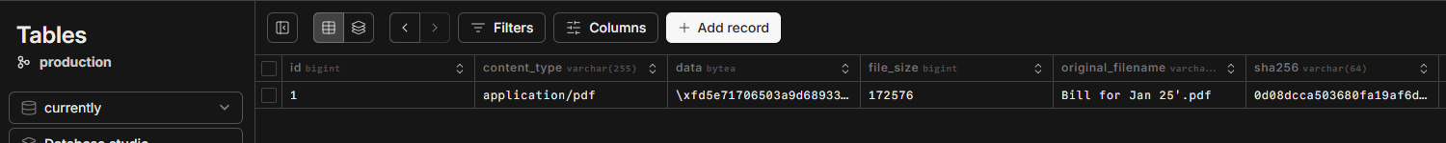
Cyber Aspect
Secure registration and login using Spring Security
Passwords and vault PINs hashed with BCrypt
JWT authentication for protected API routes
Ownership checks prevent users accessing other users’ data
Input validation on backend request data
CORS allowlist controls which frontend origins can call the API
Rate limiting protects sensitive endpoints
Sensitive user data is handled securely with encryption/hash fields

Slide 7
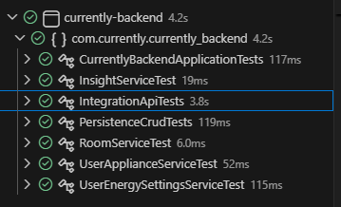
Testing
Backend tested using JUnit 5, Mockito, Spring Boot Test, MockMvc and Maven
Used a mix of:
Unit testing for service logic
Integration testing for API endpoints
End-to-end backend journey testing using MockMvc
Persistence testing for database rules and relationships
Security/ownership testing for protected user data
Initial full test run found 5 failures and 4 errors
After debugging and retesting: 39 tests passed, 0 failures, 0 errors
Evidence recorded in Test Report #1 and Test Report #2
39 Automated Backend Tests Passed

Slide 8
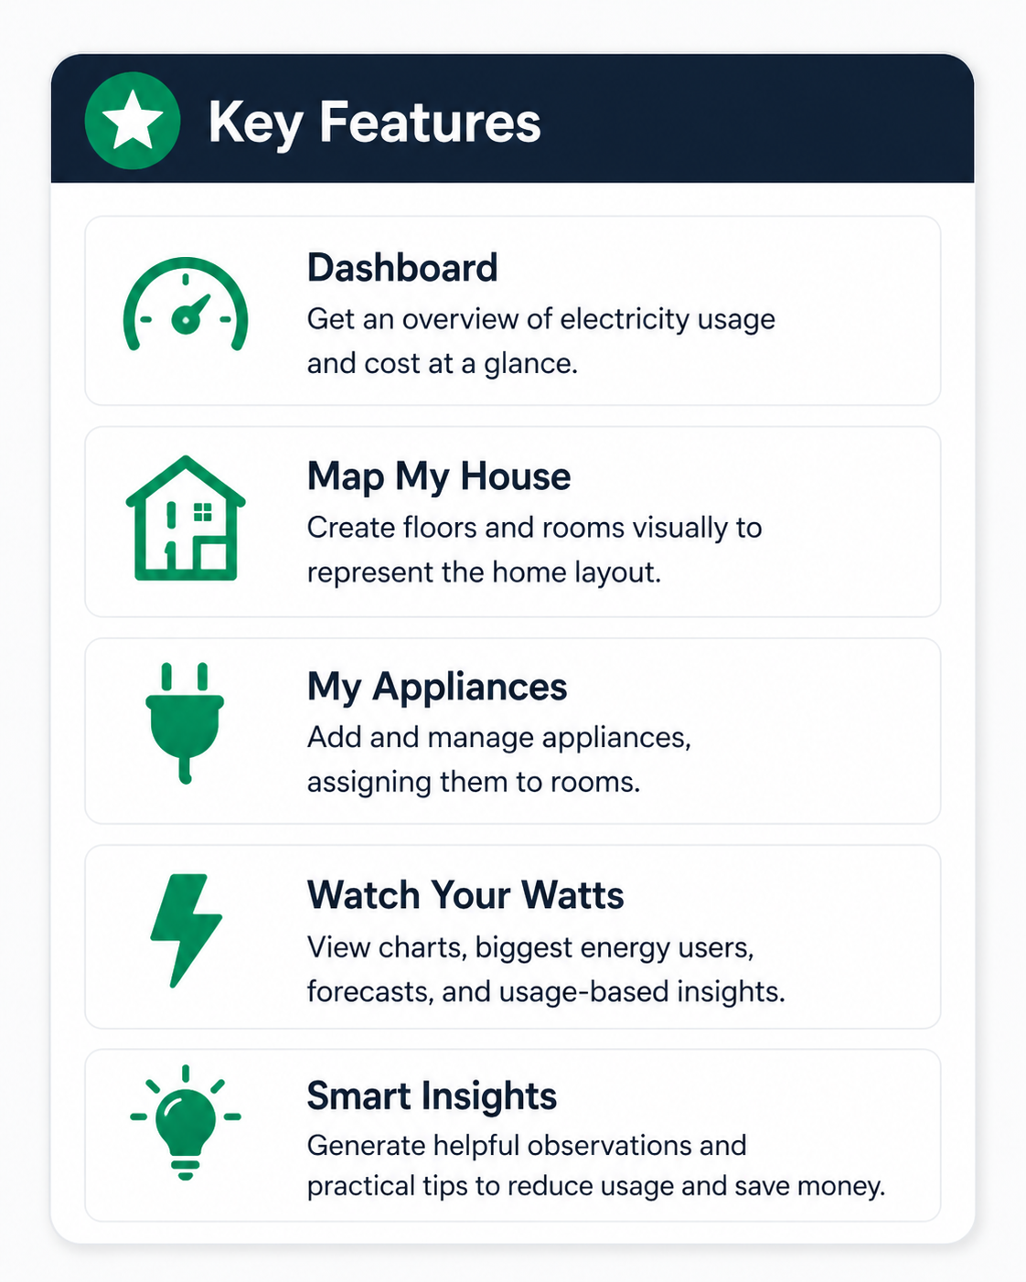
Live Demo
Dashboard
Map My House
My Appliances
Watch Your Watts and Bills Vault
Smart Insights

